Slide 1

Video Based Vehicle Detection and Speed Estimation
Vishwakarma Institute of Technology, Pune
Course Project : TY 2022 - 2023
Group Members:
Akash Bhadange
Resham Bhattad
Pratik Daga
Department of E&TC Engineering

Slide 2


Index
Introduction
Literature Review
Research Gap
Novelty
Methodology
Results and Analysis
Conclusion
References

Slide 3

Introduction
Advanced analysis of road traffic data is an essential component of today’s intelligent transportation systems.
Road safety and and reducing accidents is a very crucial issue.
This project focuses on vehicle detection and tracking and speed estimation.
Image subtraction is used to detect moving vehicle.
Speed of a vehicle can be estimated when a tracked vehicle covers a segment of road.

Slide 4


Literature Review

Slide 5
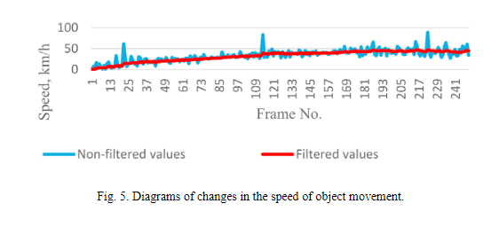
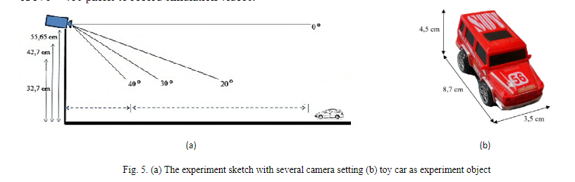
Literature Survey
Determining vehicle speed based on video using convolutional neural network [1]
Count and classify vehicles and determine their speed.
Used a two-stage Faster R-CNN detector together with a SORT tracker
Error not exceeding 22%
Detection of Vehicle Position and Speed using Camera Calibration and Image Projection Methods [2]
Direct Linear Transformation is used for estimating the length of a segment of road.
Vehicle position is detected using Background Subtraction
speed is determined by Mixture of Gaussian (MoG)
Camera Calibration is used to calculate target position of vehicle in 3D space.
Python libraries OpenCV and Kivy were used.

Slide 6
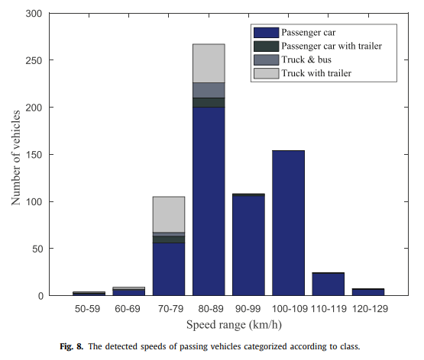
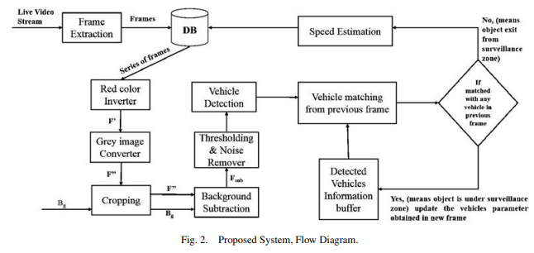
Literature Survey
Vehicle speed measurement model for video-based systems [3]
Foreground, BG separation. Gaussian Mixture Model.
The detection distance is directly proportional to the vehicle’s speed and inversely proportional to the camera’s frame rate.
An average error of 1.77 %.
An Efficient Approach for Detection and Speed Estimation of Moving Vehicles [4]
Image acquisition, preprocessing and background is modelled.
Camera calibration is used to map the relationship with real world.
Region of interest.
S = d*f/n

Slide 7
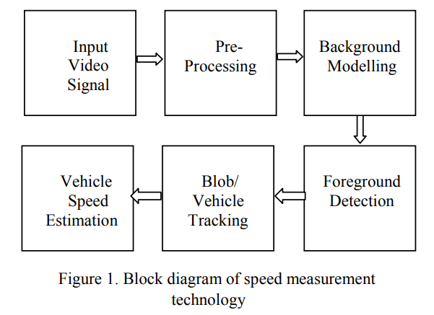
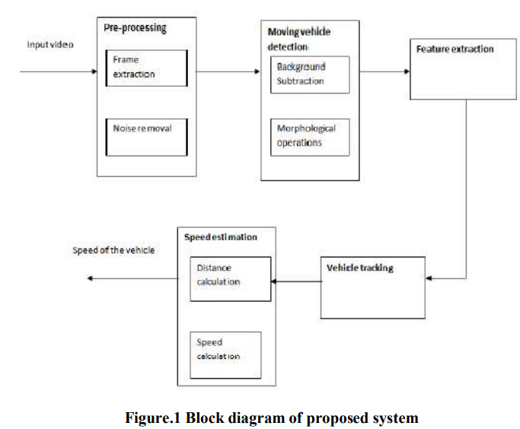
Literature Survey
Development of Automated Technique for Vehicle Speed Estimation and Tracking in Video Stream [5]
Background modeling, foreground detection.
Vehicle tracking/Blob detection through all frames.
Speed Calculation/Number of frames, frame rate & distance traversed by vehicle.
Vehicle Tracking and Speed Estimation of Moving Vehicles for Traffic Surveillance Applications [6]
Background subtraction using Mixture of Gaussian
Feature extraction using Shi-Tomasi technique
Speed/considering the centroid at each instance of a frame and distance will be calculated

Slide 8

Research Gap
Multiple vehicles detection
Classification of vehicles
Two vehicles moving extremely close/detected as a single object
Less features

Slide 9
Novelty
Multiple vehicles can be detected, and their speeds can be detected
Simpler algorithms
Save Vehicle Data

Slide 10
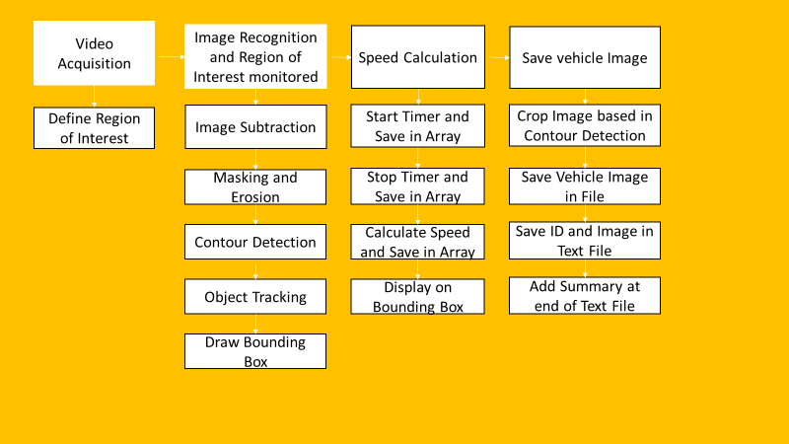
Methodology

Slide 11
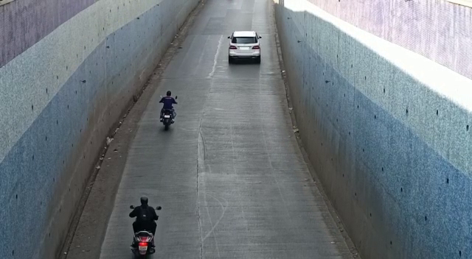
Video Acquisition
The video used in this project is a street view in Pune.
The number plates of the vehicle in the video are however not clearly visible.

Slide 12
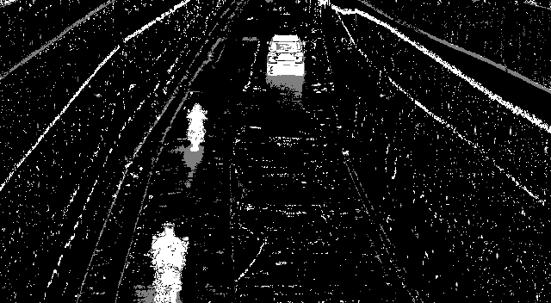
Region of Interest and Masking
Region of Interest (ROI) takes a smaller portion of the original video.
On this ROI, Image subtraction is performed to detect a moving vehicle. (Image Subtraction helps find the difference between two frames).
Masking is performed to make the moving vehicles appear white and the rest of the image black.
Masked Image

Slide 13
Contour Detection and Object Tracking
Based on the area threshold of number of pixels, the contours are detected.
The threshold is used to avoid detecting contours of smaller moving objects that are not vehicles.
The object is tracked based on the distance between two contours between frames.
An ID is assigned to each contour.
Original Image
Masked Image
Eliminate Based on Area
Detect Contours
Object Tracking
Object Tracking

Slide 14
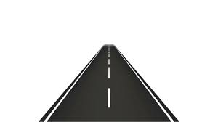
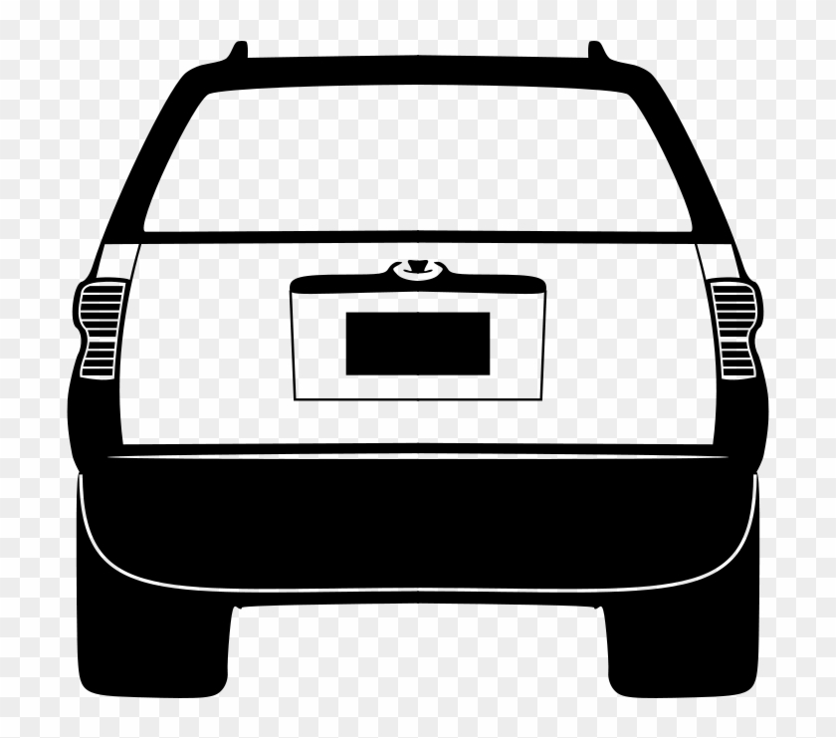
Speed Estimation
Time difference between the position of a vehicle is calculated and the speed is estimated based on a formula.
The timer starts when the vehicle crosses the first line, and the timer ends when the vehicle crosses the second line.
The speed is displayed on top of the bounding box only when the vehicle crosses both the lines.
End Timer
s2 [ID]
Start Timer
s1 [ID]

Slide 15
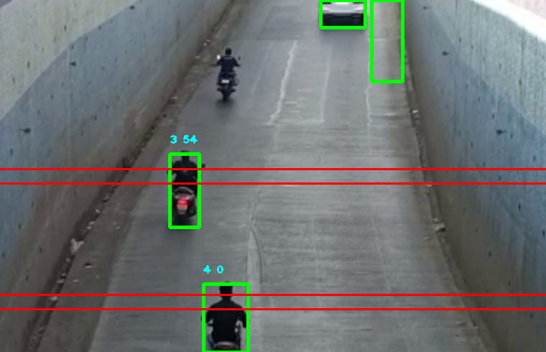
Results
Speed Detection
Successfully able to track vehicles and estimate their speed
Accuracy in detecting vehicles is 100% as long as there is no movement in the camera
Multiple vehicles can be detected, and their speeds can be detected.

Slide 16
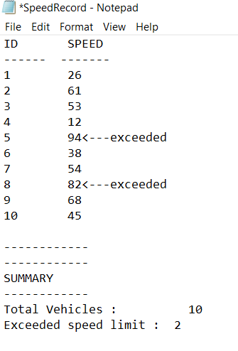
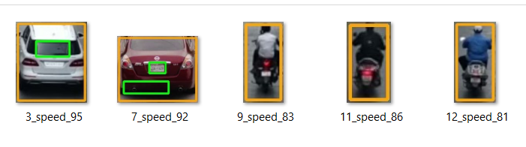

Results
3. Save Vehicle Data
2. Summary of vehicles
3. Speed Exceeded vehicles
ID_Speed_60

Slide 17
Conclusion
This project is able to estimate speed of vehicles and save vehicle data
Multiple vehicles can be detected, and their speeds can be detected
This project requires the camera to be as still as possible, as movement is used to distinguish vehicles from the background
Road safety is an important factor for the police force
Future Improvements can be finding other violations like wrong lane detection and tailgating detection

Slide 18
References
Alexander Grents, Vitalii Varkentin, Nikolay Goryaev, Determining vehicle speed based on video using convolutional neural network, Transportation Research Procedia, Volume 50, 2020, Pages 192-200, ISSN 2352-1465, https://doi.org/10.1016/j.trpro.2020.10.024.
Alexander A S Gunawan, Deasy Aprilia Tanjung, Fergyanto E. Gunawan, Detection of Vehicle Position and Speed using Camera Calibration and Image Projection Methods, Procedia Computer Science, Volume 157, 2019, Pages 255-265, ISSN 1877-0509, https://doi.org/10.1016/j.procs.2019.08.165.
Saleh Javadi, Mattias Dahl, Mats I. Pettersson, Vehicle speed measurement model for video-based systems, Computers & Electrical Engineering, Volume 76, 2019, Pages 238-248, ISSN 0045-7906, https://doi.org/10.1016/j.compeleceng.2019.04.001.
Tarun Kumar, Dharmender Singh Kushwaha, An Efficient Approach for Detection and Speed Estimation of Moving Vehicles, Procedia Computer Science, Volume 89, 2016, Pages 726-731, ISSN 1877-0509, https://doi.org/10.1016/j.procs.2016.06.045.
S. S. Wardha, S. M. Deokar, S. S. Patankar and J. V. Kulkarni, "Development of automated technique for vehicle speed estimation and tracking in video stream," 2017 2nd IEEE International Conference on Recent Trends in Electronics, Information & Communication Technology (RTEICT), 2017, pp. 940-944, doi: 10.1109/RTEICT.2017.8256736.
P. M. Dhulavvagol, A. Desai and R. Ganiger, "Vehical Tracking and Speed Estimation of Moving Vehicles for Traffic Surveillance Applications," 2017 International Conference on Current Trends in Computer, Electrical, Electronics and Communication (CTCEEC), 2017, pp. 373-377, doi: 10.1109/CTCEEC.2017.8455043.

Slide 19

Thank You!

Slide 20

Any Questions?

